Slide 1
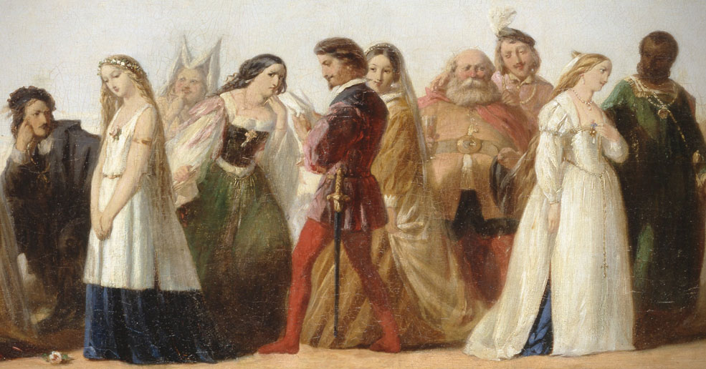
Automated Ticketing System for CTA

Slide 2

Introduction
Development of an Electronic Ticketing System for the Centrala Underground
Means to improve tagging proficiency, lessen misrepresentation, and upgrade client accommodation
Notes:
The Electronic Ticketing System for the Centrala Underground means to modernize charge assortment by presenting a protected, effective, and easy to use computerized stage. This framework will supplant conventional paper tickets with contactless computerized other options, decreasing lines and functional expenses while further developing traveler experience. By consolidating QR codes, NFC innovation, and constant information synchronization, the framework guarantees consistent travel, upgraded security, and viable administration of travel tasks.

Slide 3
Overview of functionality
Allow users to select boarding and destination zone
Calculates total zones traveled
Supports different types of passengers
Displays total calculated fare
Notes:
The Electronic Ticketing System for the Centrala Underground offers a consistent and easy to understand insight by permitting travelers to choose their boarding and objective zones. It consequently works out the all out zones voyaged and decides the passage appropriately. The framework upholds different traveler classifications, including Grown-up, Kid, Senior, and Understudy, guaranteeing fair valuing. When the charge is determined, it is shown prior to giving a computerized travel voucher with the date and time, empowering a problem free and proficient driving experience.

Slide 4
Ticket pricing and calculation
Adult: 2105 CENTS per zone
Child: 1410 CENTS per zone
Senior: 1025 CENTS per zone
Notes:
Despite the potential of Bihar’s youth, students in both urban and rural areas oftThe ticket evaluating for the Centrala not entirely settled by the quantity of zones a traveler goes through, increased by the individual charge per traveler type. For Grown-ups, the admission is 2105 Pennies for every zone, while Kids are charged 1410 Pennies for each zone. Seniors partake in a decreased toll of 1025 Pennies for each zone, and Understudies are charged 1750 Pennies for every zone. This estimating structure guarantees a fair and reasonable travel experience customized to various traveler classes, with straightforward computations in light of the excursion's length, advancing openness and comfort for all.en struggle with a lack of career awareness and misaligned educational choices. Societal pressures, financial limitations, and a lack of structured guidance exacerbate this challenge, leaving students ill-equipped for modern job markets.
For example:
Rural students often lack exposure to diverse career options and rely heavily on conventional pathways like government jobs.
Urban students face challenges aligning their academic achievements with their career aspirations due to limited access to mentorship.
Addressing these gaps requires a transformative approach to education—one that integrates career guidance, skill-building, and mentorship at its core.

Slide 5
User Interface Design
Stations Board: Displays zone and different stations
Allows users to select start and destination zones
Records the details of all the passenegers
Notes:
The UI Plan of the Electronic Tagging Framework guarantees a smooth and natural experience for travelers. The Stations Board noticeably shows the accessible zones and stations, permitting clients to distinguish their movement choices without any problem. The Menu Choice element empowers clients to helpfully choose their beginning and objective zones. An Information Structure catches fundamental traveler subtleties, including classes like Grown-ups, Youngsters, Seniors, and Understudies. When the subtleties are presented, the framework creates a Voucher Show showing the ticket subtleties, toll breakdown, and aggregate sum, giving an unmistakable and straightforward synopsis of the charge and excursion data.

Slide 6
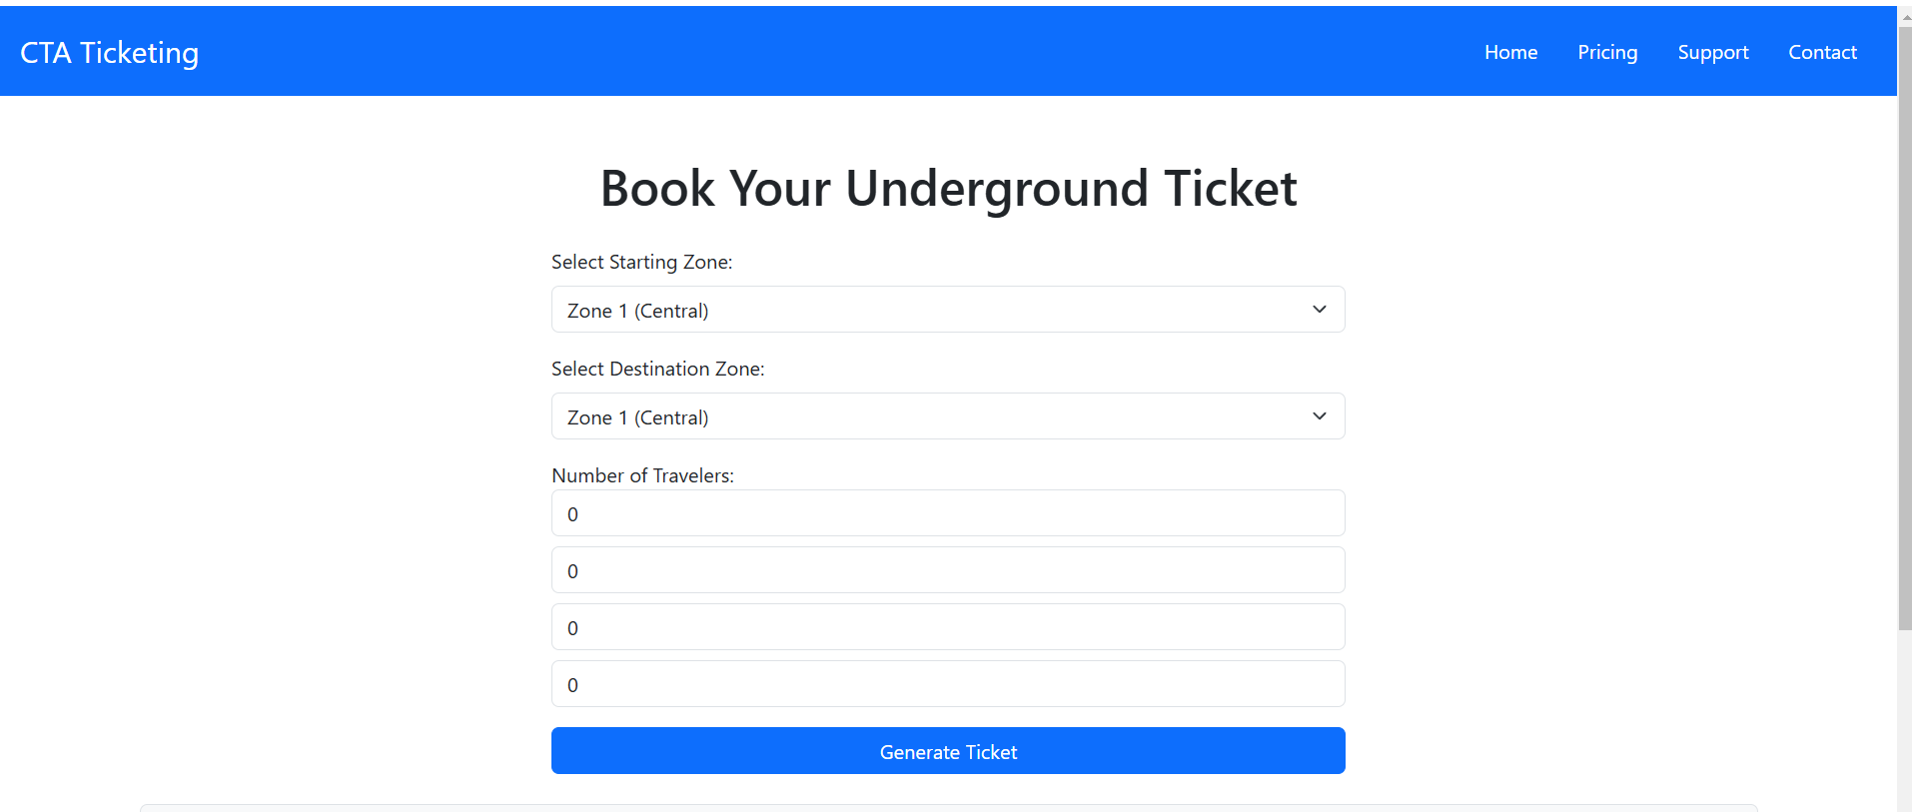
User Interface Mockups
Main Menu Passenger Input Screen
Voucher Display
Notes:
The UI Mockups for the Electronic Ticketing System are intended for clearness and usability. The Fundamental Menu Screen includes a zone determination interface, where clients can pick their boarding and objective zones effortlessly. The Traveler Info Screen prompts clients to choose the quantity of voyagers from classifications like Grown-ups, Kids, Seniors, and Understudies, guaranteeing precise charge estimation. When the subtleties are placed, the Voucher Show screen shows a passage breakdown with an unmistakable outline of expenses, all out charge, and excursion subtleties. Furthermore, clients are given a choice to print their movement voucher for comfort.

Slide 7
Conclusion
Improved Efficiency
Fair and transparent pricing
Enhanced user experience
Notes:
The Electronic Ticketing System upgrades the effectiveness and openness of travel administrations while guaranteeing straightforwardness in toll computations. The subsequent stages being developed incorporate coordinating installment doors, executing ongoing ticket approval, and leading client testing to refine the framework. Moreover, a versatile application rendition could be created to extend openness and further develop client comfort.

